Slide 1
AWS Network Infrastructure Design for A Medical Company
Shivam Sinha

Slide 2
Agenda
Introduction
Executive Summary
Requirements and Assumptions
Architecture Diagram
Network and Security
Scalability, High Availability (HA), and Business Continuity
Monitoring and Auditing
Next Steps and Conclusion

Slide 3
Introduction
Problem Statement:
A Medical Company requires a scalable, secure, and highly available AWS infrastructure to support its online medical social networking and diagnosis assistance application.
Solution:
We have architected an AWS-based solution that meets their needs for secure data handling, high availability, and business continuity while ensuring scalability and resilience.

Slide 4
Executive Summary
This project focuses on migrating the existing on-premises architecture, currently deployed on Microsoft servers, to a scalable and highly available cloud-based solution on AWS. The current setup includes a web tier, application tier, and database tier, each running on physical servers with specific configurations.
Web Tier: Comprises two physical servers, each with two CPUs and 4 GB of memory, running Microsoft Windows 2016 Base with Internet Information Services (IIS). A high-availability proxy load balancer is used to distribute traffic between these web servers.
Application Tier: Includes two physical servers, each with four CPUs and 16 GB of memory, also running Microsoft Windows 2016 Base with IIS. Traffic between these application servers is managed by a high-availability proxy load balancer.
Database Tier: Consists of one physical server with eight CPUs, 32 GB of memory, and 5 TB of storage, running SQL Server Standard Edition on Microsoft Windows 2016 Base. The database is managed by DBAs with no requirement for advanced RDBMS configurations.
Notes:
Ale

Slide 5
Requirements
Application Access:
The Medical Company application must have the capability to read and write data to S3 buckets
Network and Architecture:
Access Permissions:
Follow AWS best practices for configuring access permissions.
Network Design:
Build networks conforming to AWS best practices.
Implement Load Balancers supporting HTTP, HTTPS, and TCP protocols.
Scalability:
capable of scaling to handle double the number of servers.
User Groups and Access:
System Administrator Group:
2 users
Requires programmatic access and AWS Management Console access.
Database Administrator Group:
2 users
Requires programmatic access and AWS Management Console access.
Monitoring Group:
4 users
Requires AWS Management Console access only, with monitoring capabilities for infrastructure resources (EC2, S3, RDS for the application).
Authentication Mechanism:
Multi-Factor Authentication (MFA):
Administrators must use a Virtual MFA device for an additional security layer.
Users must provide a username, password, and a random code generated by the MFA when signing in to the console.
Password Policy:
Must include at least one uppercase letter, one lowercase letter, one number, and one special character.
Passwords must be changed every 90 days.
Users cannot reuse the last three passwords.

Slide 6
Assumptions
User Roles and Access:
Users are assigned to specific groups with defined roles and permissions.
System Administrators and Database Administrators will require both AWS Management Console and programmatic access.
Monitoring Group users will only require AWS Management Console access.
Password Policy:
A standard password policy is enforced across all user accounts.
Password changes and re-use policies are strictly adhered to.
Application Requirements:
The Medical Company application has specific requirements for accessing and interacting with AWS S3 buckets.
Network and Architecture:
The architecture is designed to support scaling and redundancy, matching the current server hosting company setup.
The system is built for business continuity and resilience.
Security and Compliance:
Compliance with regulations related to the handling of sensitive medical information is mandatory.
Auditing and monitoring are essential to track all user actions and access.
the Medical Company application is already configured to interact with AWS S3 for data storage and retrieval.

Slide 7
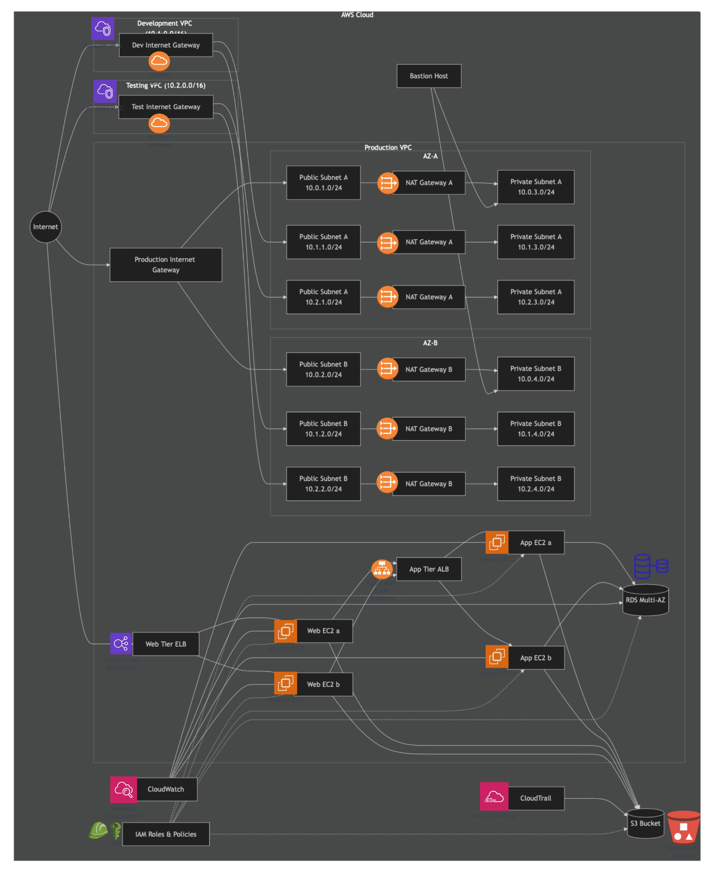

Architecture

Slide 8
Network and Security
Load Balancers:
Web Tier Load Balancer (ELB): Distributes incoming web traffic across multiple EC2 instances in public subnets to ensure availability and scalability.
Application Tier Load Balancer (ALB): Manages traffic between web and application tiers, enhancing security by separating public-facing and internal communications.
IAM Roles and Policies:
EC2 and RDS Roles: Assign roles to instances to allow controlled access to AWS services like S3, ensuring that permissions are granted only as necessary.
CloudTrail and CloudWatch:
CloudTrail: Provides continuous monitoring and logging of API activity in AWS, enabling detailed audit trails for security and compliance.
CloudWatch: Monitors and alerts on the health and performance of resources, helping to detect and respond to security incidents and performance issues.
Bastion Host:
Secure Access: Deployed in a public subnet to securely access instances in private subnets, minimizing the attack surface and enhancing overall security.
Virtual Private Clouds (VPCs):
Isolated Network Environments: Each environment (Production, Development, Testing) is set up in its own VPC with dedicated CIDR blocks, ensuring separation of resources and enhanced security.
Subnet Design: Public and private subnets are strategically placed across multiple Availability Zones (AZs) to ensure high availability and fault tolerance.
Internet Gateways and NAT Gateways:
Internet Gateways (IGW): Enable internet access for public subnets, allowing instances that require direct internet access to communicate with external services.
NAT Gateways: Provide internet access for instances in private subnets while keeping them shielded from direct internet traffic, enhancing security.
Route Tables:
Public Route Tables: Direct traffic from public subnets to the internet through IGWs.
Private Route Tables: Route traffic from private subnets to the internet through NAT Gateways, ensuring that private instances can access the internet without exposing them directly.
Security Groups:
Web Tier Security Group: Allows HTTP and HTTPS traffic from the internet, ensuring secure and controlled access to web servers.
Application Tier Security Group: Restricts access to application servers to only traffic originating from the web tier, protecting application logic.
Database Tier Security Group: Limits database access to application servers only, reducing the risk of unauthorized access.

Slide 9
Reasons for Selected Approach
Isolation and Segmentation: Using separate VPCs for Production, Development, and Testing environments provides isolation, reducing the risk of cross-environment issues and security breaches.
High Availability and Fault Tolerance: Distributing resources across multiple AZs and using load balancers ensure high availability and fault tolerance, minimizing downtime and maintaining service reliability.
Controlled Internet Access: Implementing IGWs and NAT Gateways ensures that only necessary resources are exposed to the internet, while private instances remain protected from direct internet access.
Granular Security Control: Security Groups and IAM roles allow fine-grained control over network access and permissions, ensuring that resources are only accessible to authorized entities.
Enhanced Monitoring and Auditing: CloudTrail and CloudWatch provide comprehensive monitoring and auditing capabilities, enabling proactive detection and response to security incidents and operational issues.
Secure Administrative Access: The Bastion Host provides a controlled and secure method for accessing instances in private subnets, reducing the risk of unauthorized access.

Slide 10
Scalability
Automatic Scaling Groups with their configuration
Best practices - providing high availability, cost efficiency…
Automatic Scaling Groups dynamically adjust the t3.medium (web) and t3.large(app) instances based on traffic and load.
High Availability is ensured by distributing instances across multiple Availability Zones, reducing the risk of downtime.
Cost Efficiency is maintained by automatically scaling down during periods of low demand, optimizing resource use.
Integration with ELB/ALB ensures that scaling events do not impact user experience, maintaining consistent performance.
Notes:
Alex

Slide 11
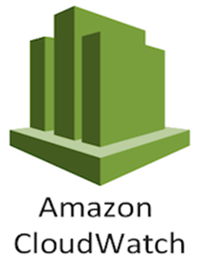
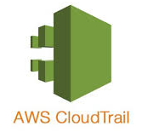


Monitoring and auditing
Enable CloudTrail for comprehensive logging of all AWS account activities.
Store logs securely in S3 buckets with restricted access.
Integrate CloudTrail with CloudWatch for real-time monitoring and alerts.
Use AWS Config to audit resource configurations and ensure compliance.
Set up metric filters in CloudWatch for detecting unauthorized actions.

Slide 12
Next Steps
Enhanced monitoring protocols - using lambda for automated analysis and notification of suspicious activity
Cost Analysis and utilization on resources
Quality of life monitoring for users and customers: is customer latency acceptable? which geolocations have the most issues? How can this be improved? -> AWS Well-architected tool

Slide 13
Thank you

